Slide 1
CA1 PART A
Haaris Sulaiman P2112815

Slide 2
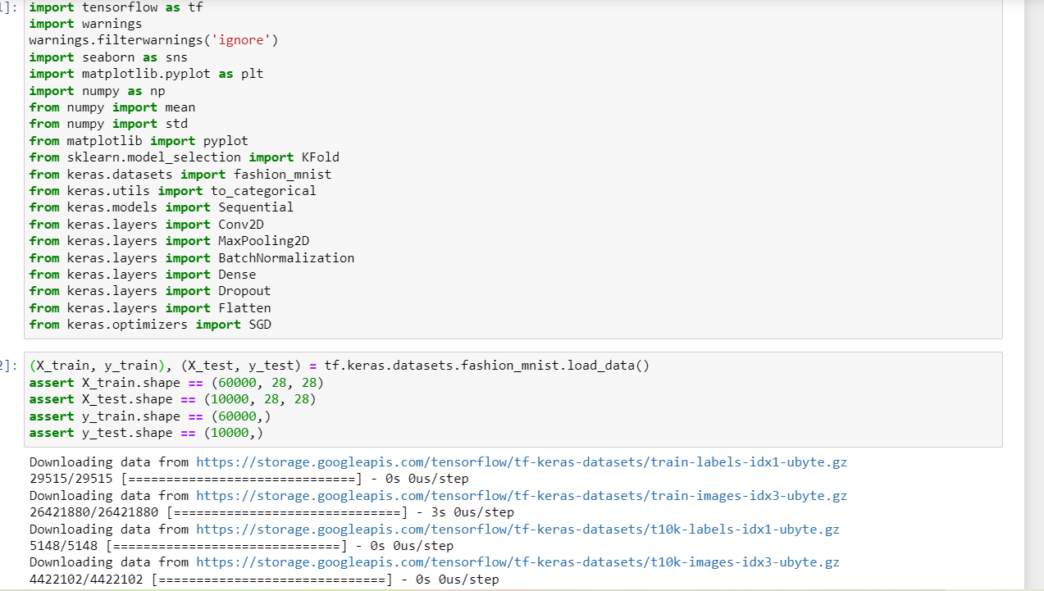
DATA LOADING

Slide 3
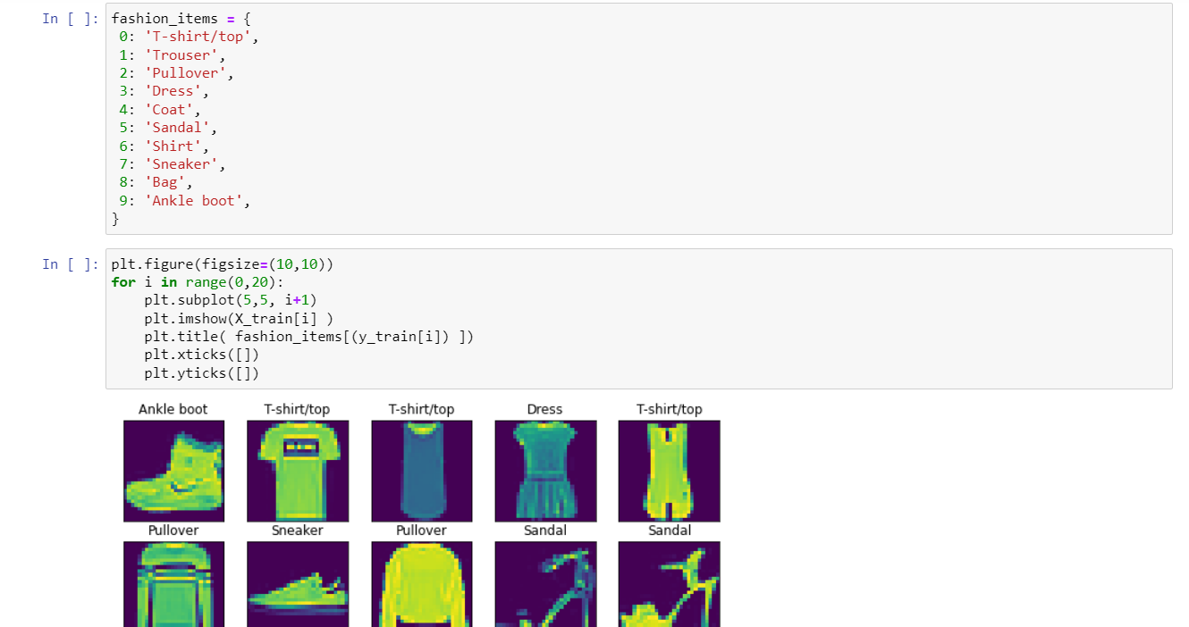
DATA VISUALIZATION

Slide 4
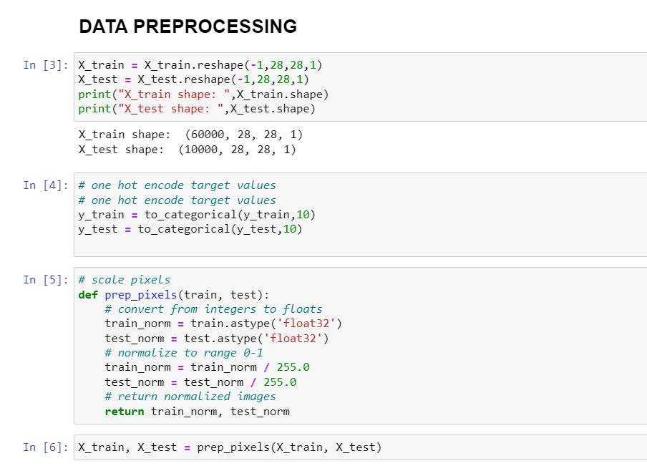
DATA PREPROCESSING

Slide 5
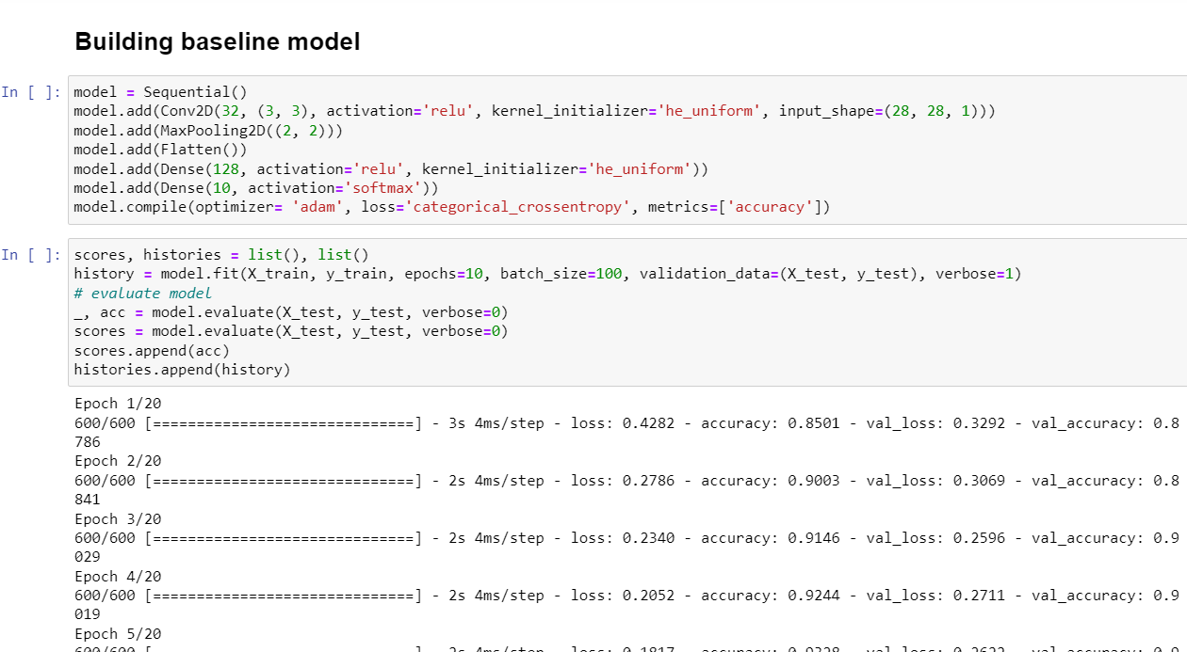
BASELINE MODEL

Slide 6
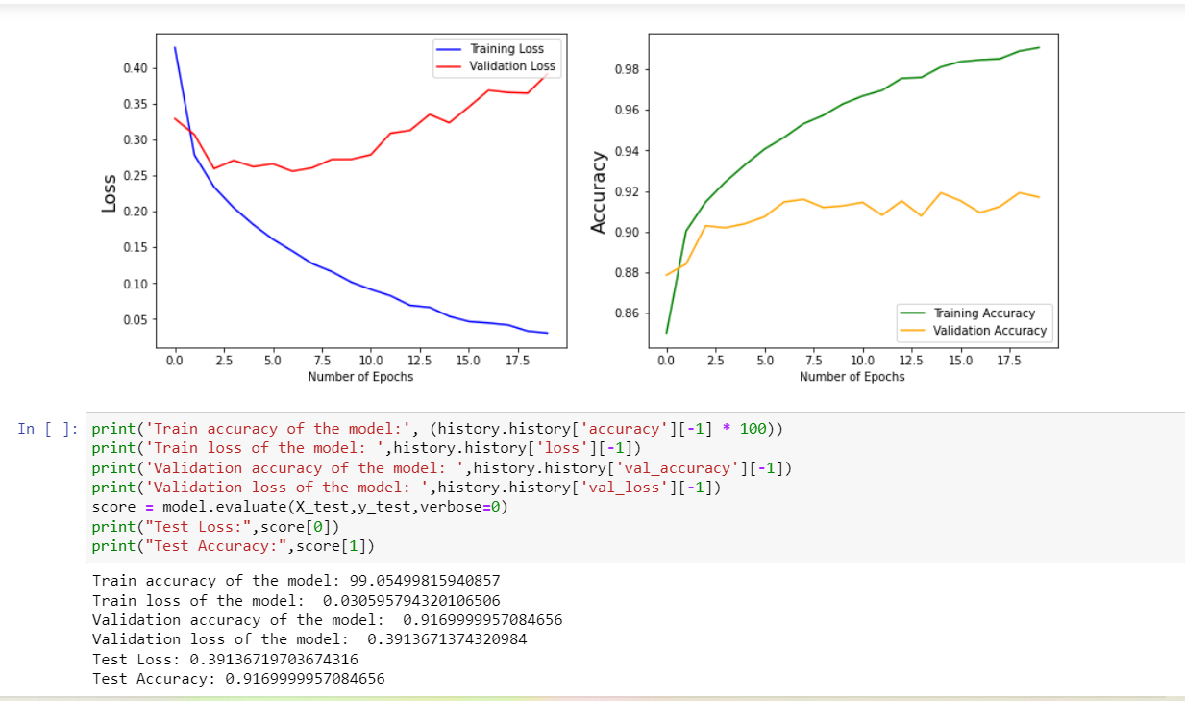
BASELINE MODEL

Slide 7
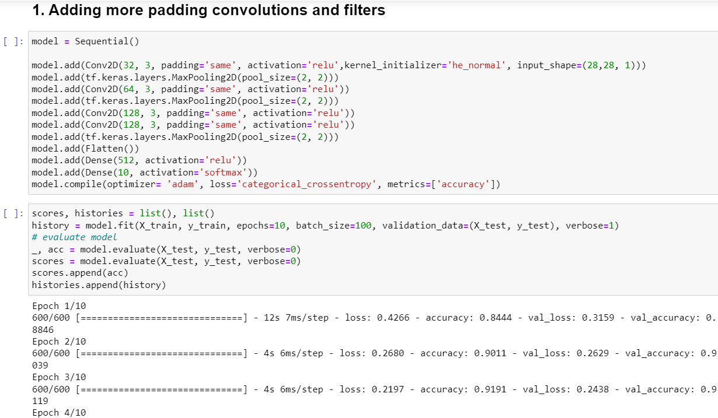
IMPROVING THE MODEL

Slide 8
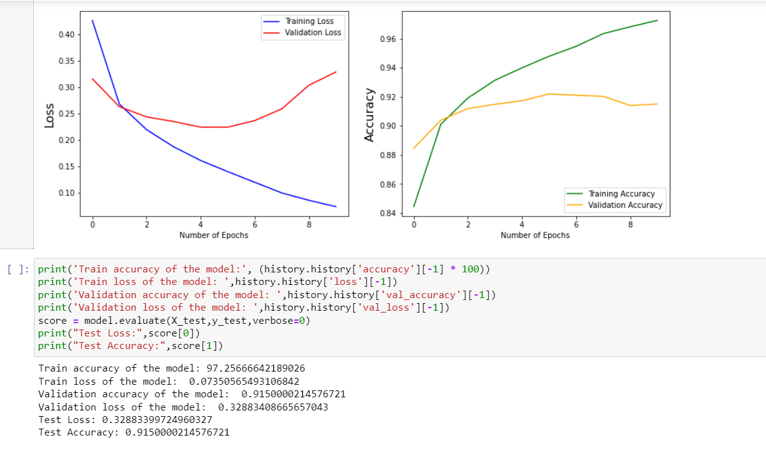
IMPROVING THE MODEL

Slide 9
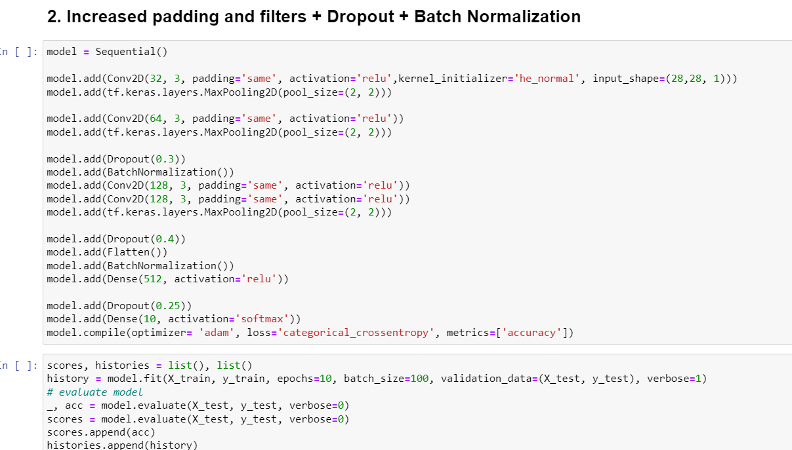
IMPROVING THE MODEL

Slide 10
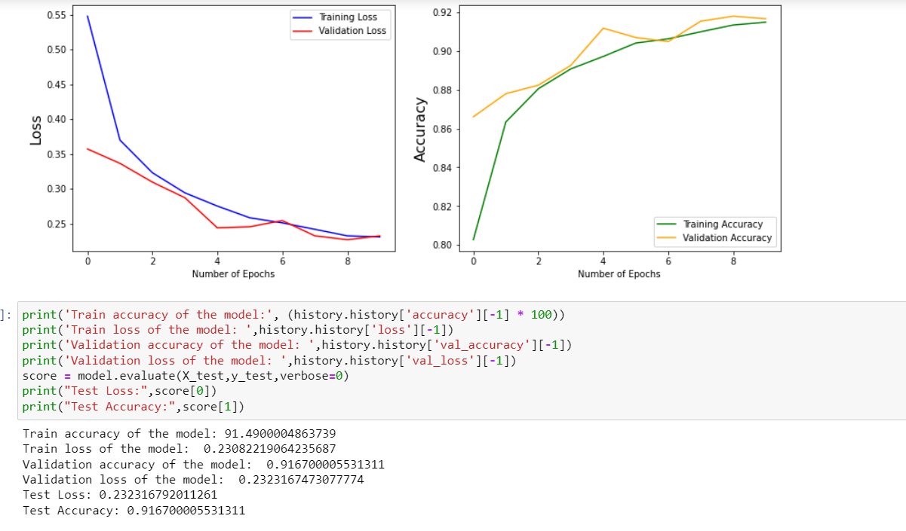
IMPROVING THE MODEL

Slide 11
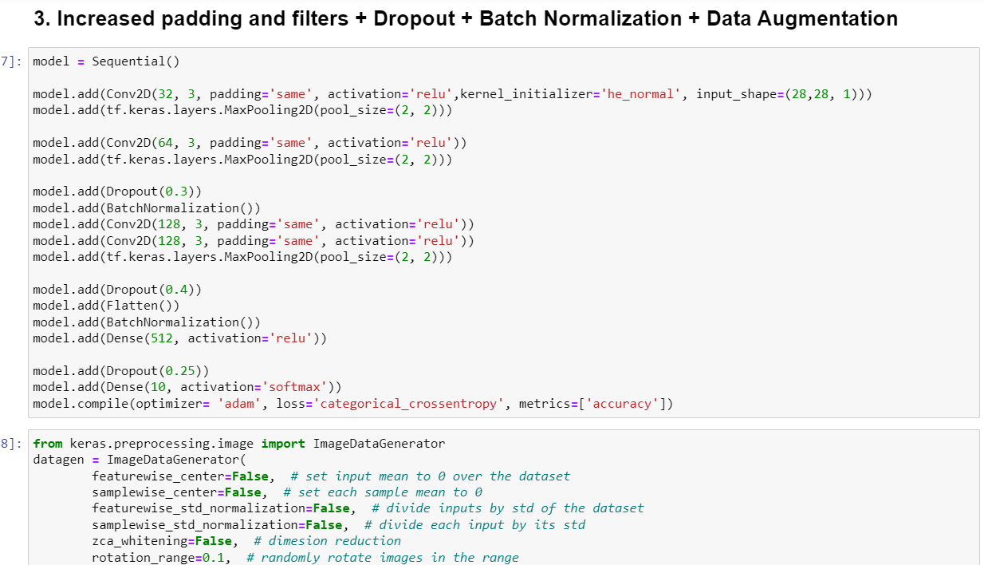
IMPROVING THE MODEL

Slide 12
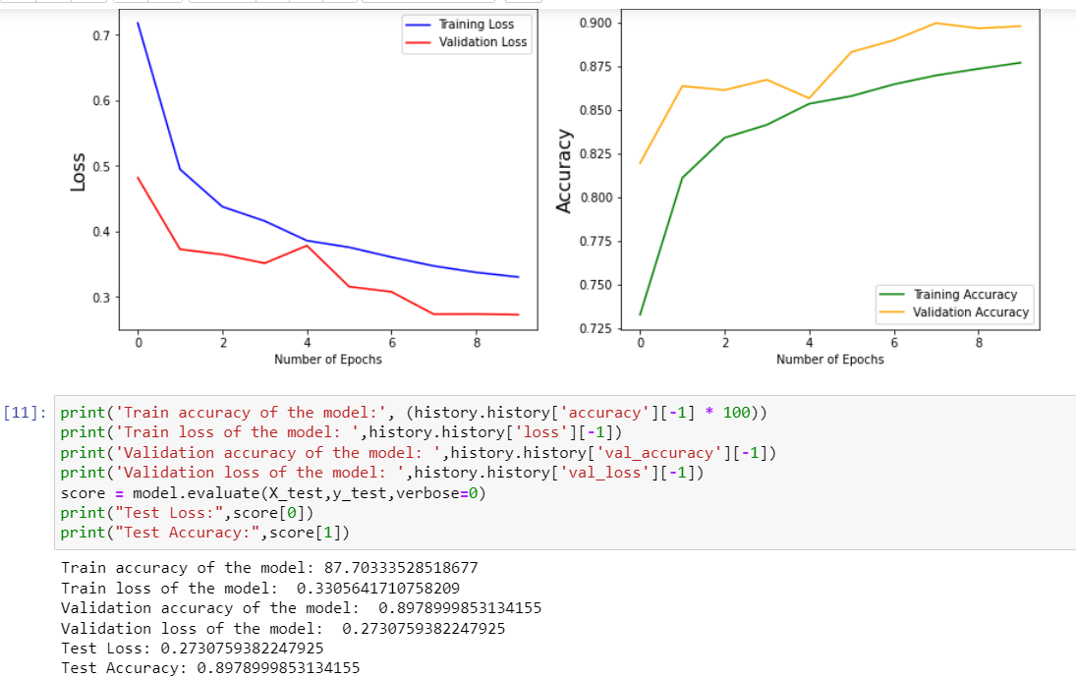
IMPROVING THE MODEL

Slide 13
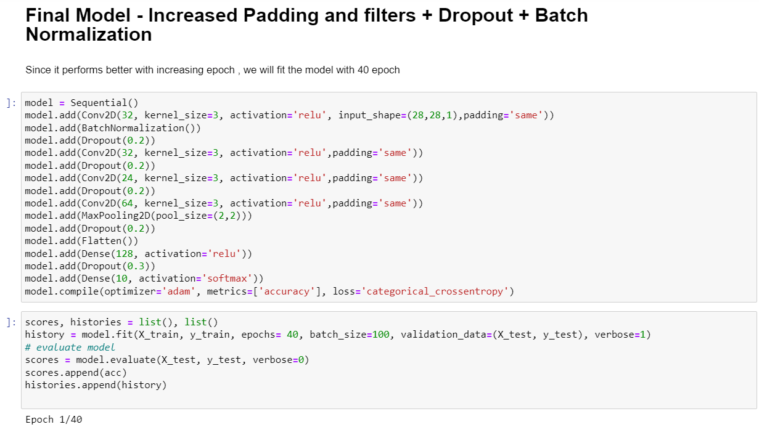
FINAL MODEL

Slide 14
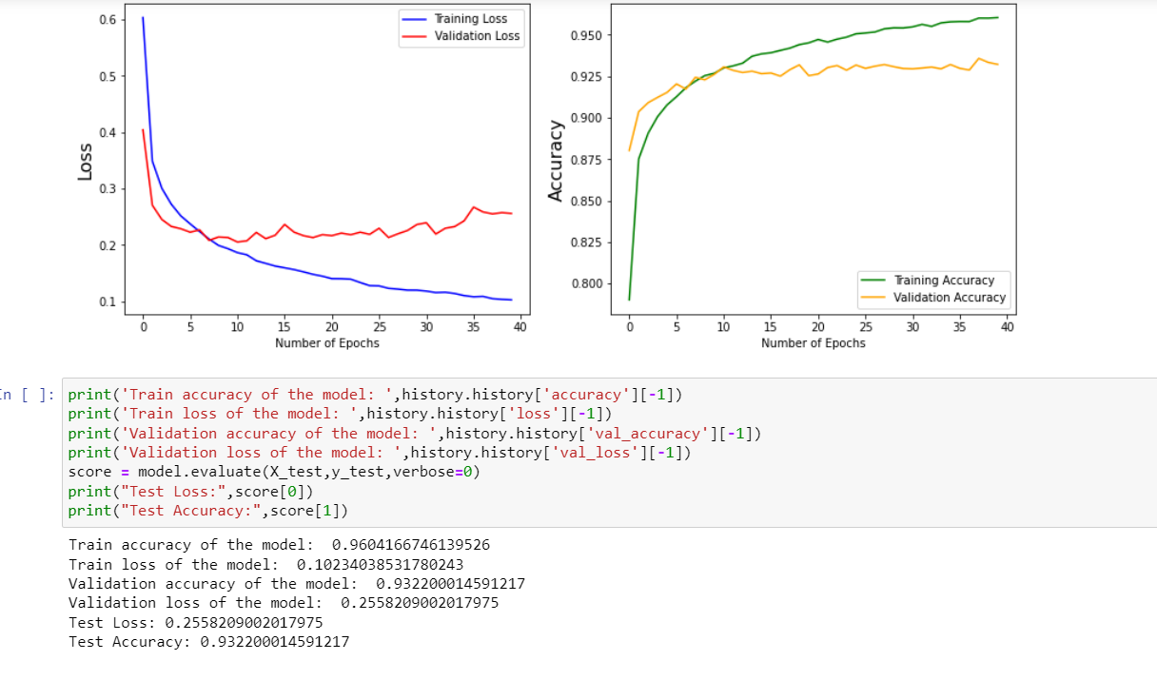
FINAL MODEL

Slide 15
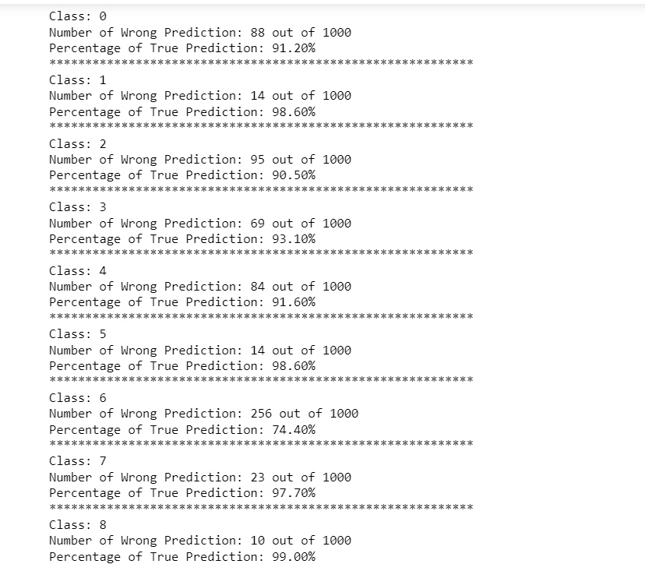
PREDICTIONS

